Slide 1
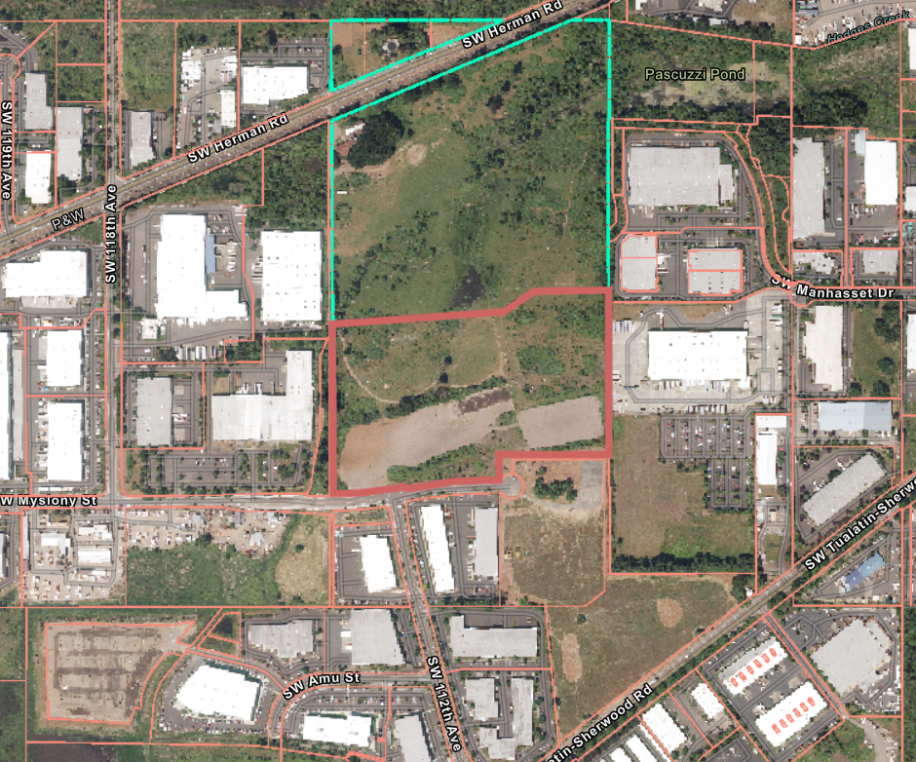
AR 21-0018
Walgraeve Industrial Park (Hedges Creek)
11345 SW Herman Road
AR 21-0018
Walgraeve Industrial Park (Hedges Creek)
ARCHITECTURAL REVIEW BOARD
June 29, 2022
Notes:
Walk you through staff report and findings
Additional information in your packet entered into the record—a public comment and staff response from our building division
SW T-S and 124th, recently annexed/far west side
43 acres
Manufacturing Business Park (MBP) Zone
Site slopes up toward the south. Northern end more developed, farm fields. Trees primarily SW corner. Wetlands and hydric soils (addressed by CWS and covered in Public Facilities decision)
Growing industrial area with history of agriculture, as well as resource extraction such as Tigard Sand and Gravel to south. ARB’s last 2 hearings actually looked at industrial buildings very near here. Tualatin Valley Water District owns land to west which is outside city and not in our future planning area.
108,000 sq. ft. office building
338 parking spaces
Utility yard, communications tower, security booth
Fence
Access
Type III
CUP and VAR reviewed for WCF height and setback + fence setback
Public Facilities separate decision….

Slide 2
Tonight’s Presentation
Site Background
Project Overview
Applicable Criteria
Conclusion
AR 21-0018
Walgraeve Industrial Park (Hedges Creek)
ARCHITECTURAL REVIEW BOARD
June 29, 2022
2

Slide 3
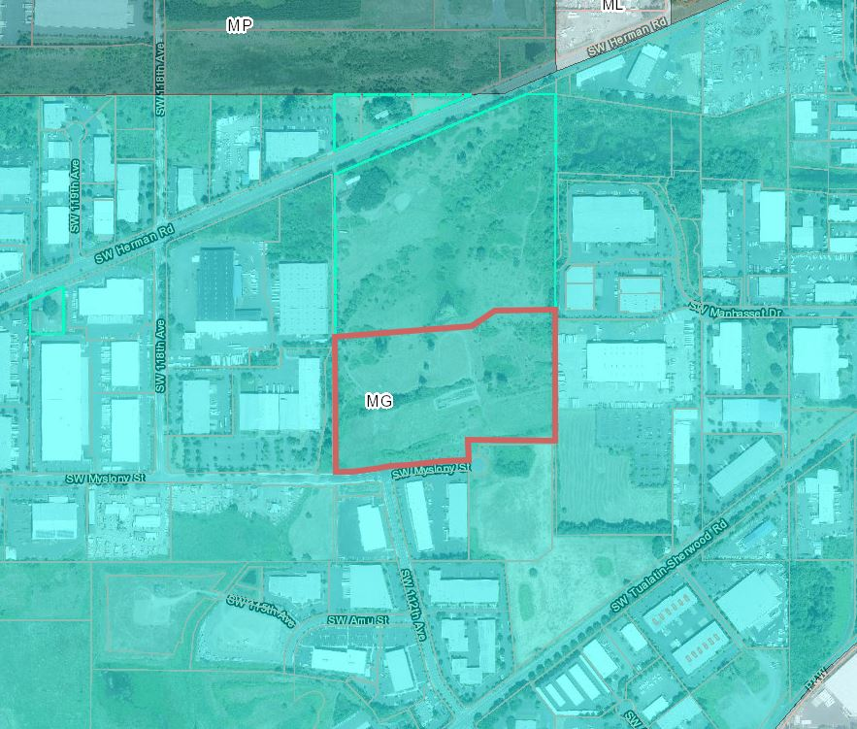
Site Background
AR 21-0018
Walgraeve Industrial Park (Hedges Creek)
ARCHITECTURAL REVIEW BOARD
June 29, 2022
3
Notes:
The vacant property is about 20.4 acres in area and is zoned General Manufacturing (MG).
The northern 10 acres of the property was recently annexed into the City.
There are industrial uses to the east, west and south.
The property will be accessed from SW Myslony Street.

Slide 4
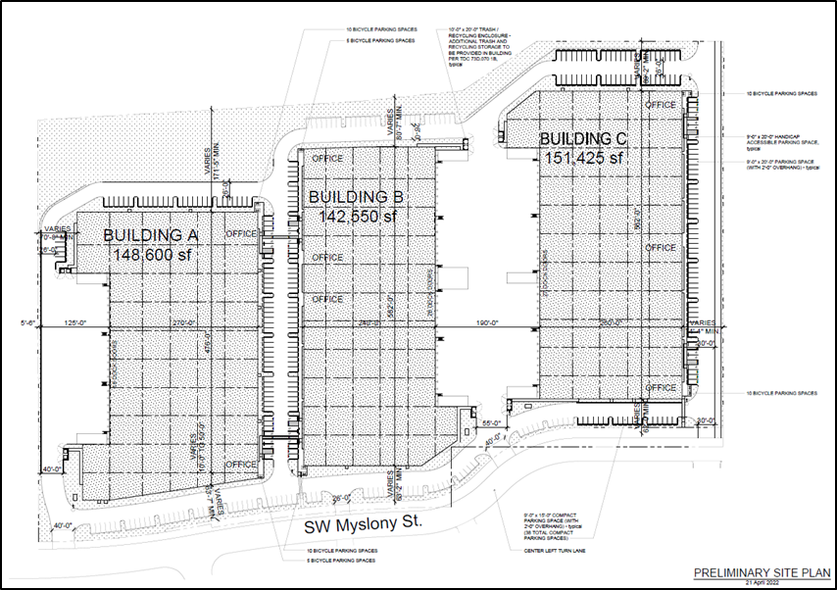
Project Overview
AR 21-0018
Walgraeve Industrial Park (Hedges Creek)
ARCHITECTURAL REVIEW BOARD
June 29, 2022
4
Notes:
- The applicant is requesting approval to construct three industrial buildings totaling approximately 442,575 square feet. Building A would be 148,600 sqft, building B would be 142,550 sqft and building C would be 151,425 sqft.
The applicant has stated that the buildings will be used for speculative warehouse and freight movement and light manufacturing uses.
The applicant’s plans illustrate a total of 8 tenant spaces.
There are 335 parking stalls, 50 bicycle parking stalls, 18 vanpool/carpool spaces and extensive loading facilities including 71 loading docks. The docks will be oriented towards the interior of Buildings B and C. Building A’s loading docks will face the western property line.
There are also 4 ingress/egress driveways that will be accessed from SW Myslony Street.

Slide 5
Procedures (TDC 32.230)
Type III Architectural Review:
Application submitted on December 29, 2021 and deemed incomplete on January 27, 2022.
The applicant made several additional submittals and the application was deemed complete on May 3, 2022.
Notice of Hearing sent on May 20, 2022
Final decision required by August 31, 2022
AR 21-0018
Walgraeve Industrial Park (Hedges Creek)
ARCHITECTURAL REVIEW BOARD
June 29, 2022
5

Slide 6
Architectural Review (TDC 33.020)
Architectural Review for Large Industrial Developments: Approval criteria listed in Chapter 73A through 73G, including:
Site Design Standards
Landscaping Standards
Parking Standards
Waste & Recyclable Management Standards
Conditions of Approval: may implement identified public facilities and services needed to serve the proposed development through Chapters 74 and 75.
AR 21-0018
Walgraeve Industrial Park (Hedges Creek)
ARCHITECTURAL REVIEW BOARD
June 29, 2022
6
Notes:
The application was reviewed for compliance with Chapters 73A thought 73G, 74 and 75. There are recommended conditions of approval listed in your report.

Slide 7
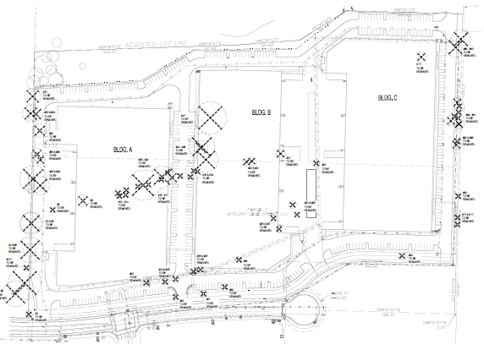
Tree Removal (TDC 33.110)
The application includes tree removal:
Approval Criteria
The tree is diseased;
The tree is a hazard;
Necessary to remove tree to construct proposed improvements
AR 21-0018
Walgraeve Industrial Park (Hedges Creek)
ARCHITECTURAL REVIEW BOARD
June 29, 2022
7
Notes:
- As allowed by code, a Tree Removal Permit application was submitted in conjunction with the Architectural Review application.
- As part of the record, a tree preservation plan and arborist report are included as Exhibit A3. 103 trees were surveyed with 77 proposed for removal for being in poor health or conflicting with building or the parking lot construction.
- Staff recommends Conditions of Approval related to tree preservation and removal standards.

Slide 8
MG Zone (TDC 61)
The proposal complies with zoning:
Setbacks
Building height
Permitted uses
STANDARD | REQUIREMENT | MIN. PROPOSAL
Setbacks:
Front (SW Myslony St) | 30 ft | 61’6” ft
Side | 0-50 ft | 70’9” ft
Parking Area | 5 ft | 5 ft
Building Height: | 60 ft | 42.8 ft
USE CATEGORY | STATUS | LIMITATIONS AND CODE REFERENCES
Warehouse and Freight Movement | P/C | Conditional use required for warehousing of building materials and supplies. All other uses permitted outright.
Light Manuracturing | P | -
AR 21-0018
Walgraeve Industrial Park (Hedges Creek)
ARCHITECTURAL REVIEW BOARD
June 29, 2022
8
Notes:
Chapter 61 provides the district regulations for the MG zone.
The applicant meets minimum setbacks and does not exceed the maximum allowable building height.
The applicant identifies warehouse and distribution and light manufacturing uses for future tenants.
Warehousing and distribution is characterized by the storage, repackaging, delivery and movement of products.
Light Manufacturing involves the assembly, fabrication, or processing of goods and materials that ordinarily do not create noise, smoke, fumes, odors, glare, or health or safety hazards.
With recommended conditions of approval, the future tenants must comply with the permitted uses in the zone.

Slide 9
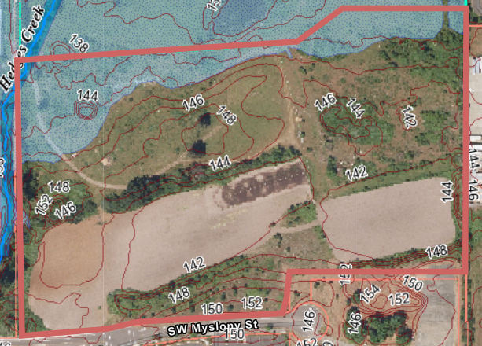
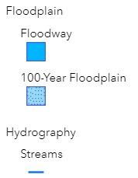
TDC 70: Floodplain District
AR 21-0018
Walgraeve Industrial Park (Hedges Creek)
ARCHITECTURAL REVIEW BOARD
June 29, 2022
9
Notes:
There’s floodplain and a small area of floodway in the northwestern corner of the property.
The applicant will be required to obtain a flood hazard area development permit illustrating compliance with TDC 70.170 and 70.180.
As shown in the analysis and findings, staff recommends conditions of approval in order to meet the requirements of Chapter 70.

Slide 10
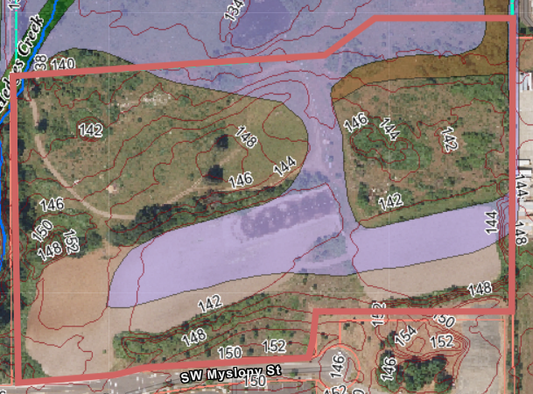
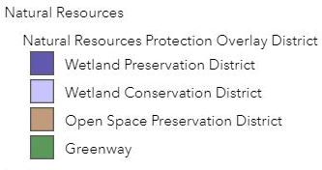
TDC 72: NRPO District
AR 21-0018
Walgraeve Industrial Park (Hedges Creek)
ARCHITECTURAL REVIEW BOARD
June 29, 2022
10
Notes:
The property contains Natural Resource Protection Areas including Wetland Conservation Natural Areas (WCNA) in purple and Open Space Natural Areas (OSNA) in brown.
Oregon Department of State Lands (DSL) and Army Corps of Engineers are reviewing a Joint Permit Application (JPA) for removal/fill activities.
As shown in the analysis and findings, staff recommends several conditions of approval related to these natural areas.

Slide 11
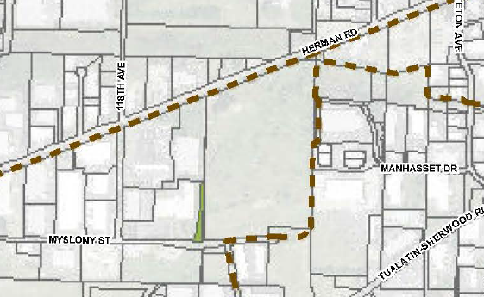
Regional Ice Age Tonquin Trail
AR 21-0018
Walgraeve Industrial Park (Hedges Creek)
ARCHITECTURAL REVIEW BOARD
June 29, 2022
11
Notes:
This is an excerpt from Map 72-2 Greenway Development Plan and Path Locations.
As illustrated here the Regional Ice Age Tonquin Trail is proposed to be constructed along the eastern property line and frontage of SW Myslony Street to the intersection of SW 112th Avenue.
The Parks and Recreation Division have provided findings recommended conditions of approval related to this trail in Exhibit E.

Slide 12
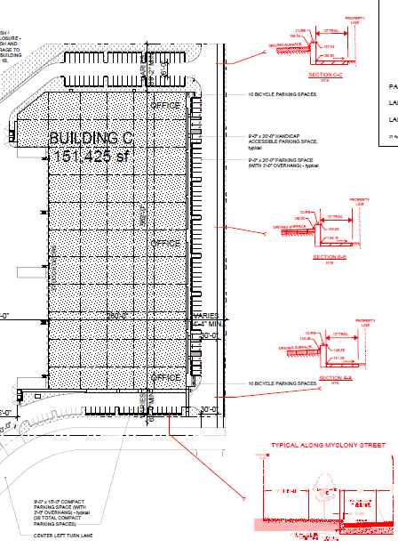
Regional Ice Age Tonquin Trail
Ice Age Tonquin Trail:
Pedestrian & Bicycle Easement along east side of property
Trail along eastern property line & along a portion of SW Myslony Street.
AR 21-0018
Walgraeve Industrial Park (Hedges Creek)
ARCHITECTURAL REVIEW BOARD
June 29, 2022
12
Notes:
As I mentioned the regional Ice Age Tonquin Trail is proposed to be located along the eastern border of the subject property and along SW Myslony Street and then continues to SW 112th Avenue.
A 15’ easement will contain a 12’ multipurpose pathway.
As shown in the analysis and findings, staff recommends conditions of approval in support of the regional Ice Age Tonquin Trail for use by pedestrians and bicycles.

Slide 13
Site Design (TDC 73A)
The proposal complies with requirements for:
Windows
Lighting
Safety and security
Storage and screening
AR 21-0018
Walgraeve Industrial Park (Hedges Creek)
ARCHITECTURAL REVIEW BOARD
June 29, 2022
13
Notes:
The proposal was reviewed for compliance with standards within Chapter 73A.
As noted in your report, there are long expanses of building walls that do not have windows.
Site lighting is adequate, the applicant has indicated that the lighting will be shielded to meet dark sky initiatives
Safety and security – lighting is adequate although the use of windows seems to be minimal in some areas where parking is located
Storage and screening – Site will have areas where semi trucks and trailers park for loading and unloading purposes.
There will also be trash enclosures.
No other outdoor storage is proposed.
As shown in the analysis and findings, staff recommends conditions of approval in support of pedestrians and apply the industrial design standards.

Slide 14
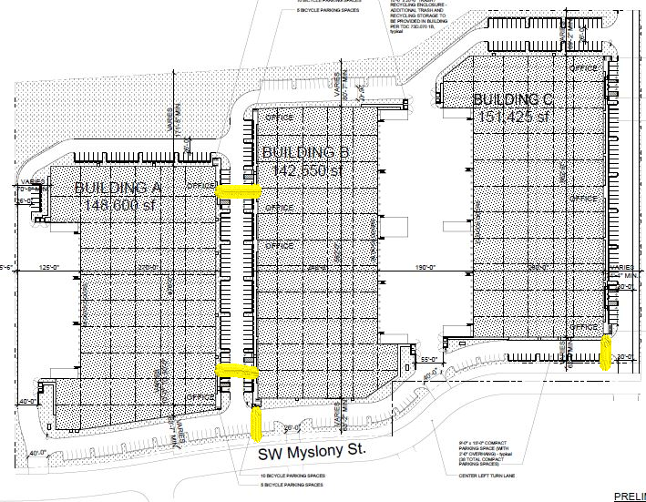
Site Design (TDC 73A)
With conditions, the proposal complies with TDC 73A.500(1):
Provide walkways between main buildings entrances and sidewalks along the public right-of-way;
AR 21-0018
Walgraeve Industrial Park (Hedges Creek)
ARCHITECTURAL REVIEW BOARD
June 29, 2022
14
Notes:
Illustrated here is the pedestrian connectivity proposed by the applicant. As shown in the analysis and findings, staff recommends standard conditions of approval to ensure walkways are clearly illustrated and meet the requirements of the development code.

Slide 15
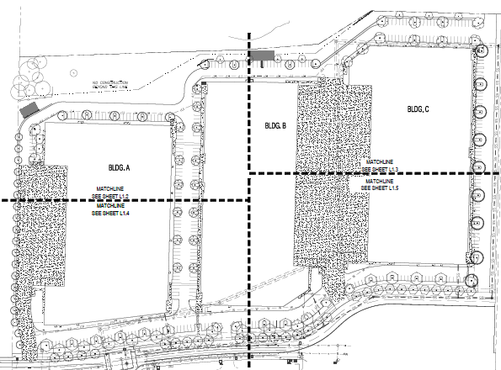
Site Design (TDC 73A)
With conditions, the proposal complies with TDC 73A.500(5):
Provide an updated landscaping plan that utilizes evergreen or conifer type trees to provide year round screening for loading dock areas.
AR 21-0018
Walgraeve Industrial Park (Hedges Creek)
ARCHITECTURAL REVIEW BOARD
June 29, 2022
15
Notes:
The location of mechanical equipment has not been determined but must be screened.
A recommended condition of approval requesting an updated landscaping plan has been provided.
Additionally, a condition of approval has been recommended to require year round screening of the loading docks by using evergreen or conifer type trees.
With the recommended conditions of approval the application will meet these requirements.

Slide 16
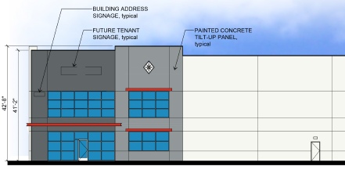
Building Design (TDC 73A)
AR 21-0018
Walgraeve Industrial Park (Hedges Creek)
ARCHITECTURAL REVIEW BOARD
June 29, 2022
16
Notes:
The Building Design Objectives listed in TDC 73A.010 promote functional, safe, innovative, and attractive buildings that are compatible with the surrounding environment.
The proposed buildings have….
- The maximum height of the buildings will be 42’ 8” tall.
- Tilt up walls will be used for these buildings.
- Entryways are painted with darker colors and have red canopies proposed in these areas to accent the main entrys.
- Most of the wall area not serving as an entrance will be painted white.

Slide 17
Building Design (TDC 73A)
AR 21-0018
Walgraeve Industrial Park (Hedges Creek)
ARCHITECTURAL REVIEW BOARD
June 29, 2022
17
Notes:
Illustrated here is Building A’s east elevations, which is typical of all three proposed buildings. There are long expanses of building wall face that do not have windows or other architectural features.
Exhibit J pertains to requests staff made pertaining to building architecture and the purpose and objective statements of Chapter 73A.

Slide 18
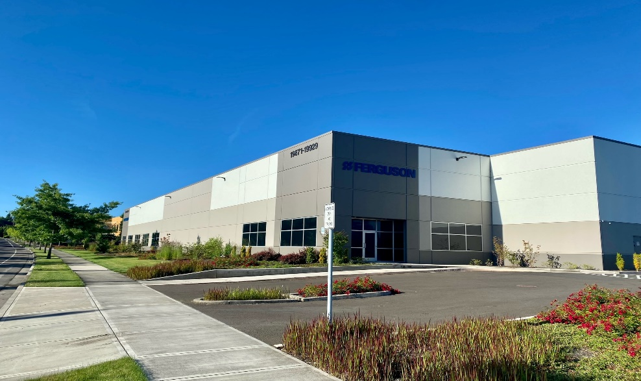
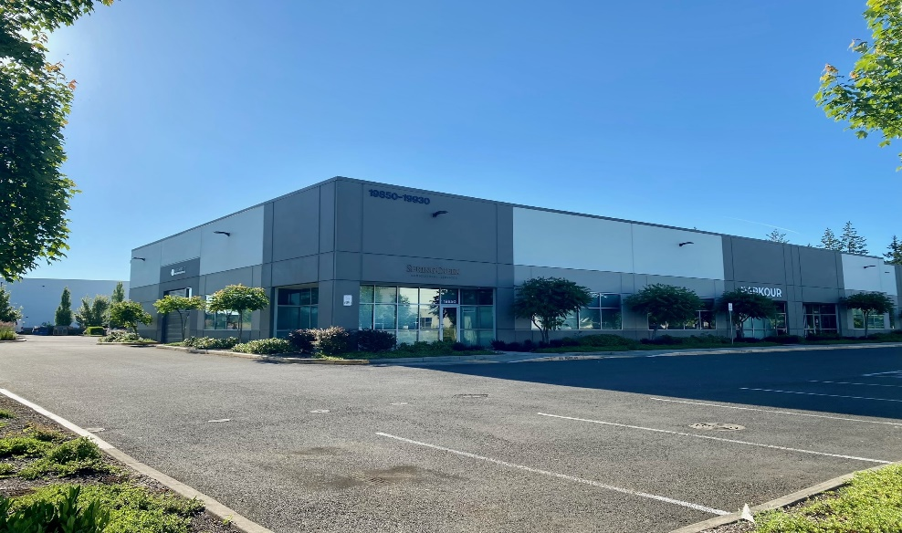
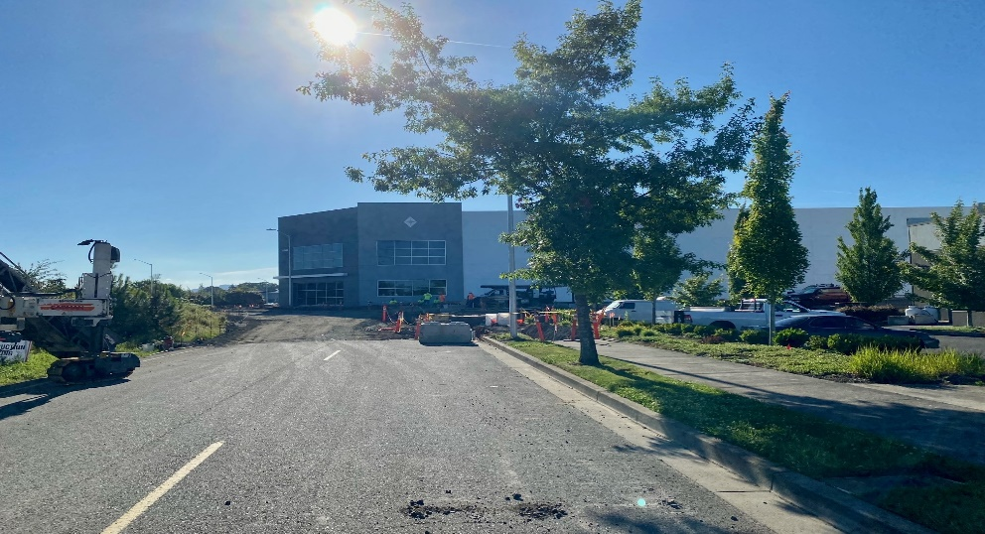
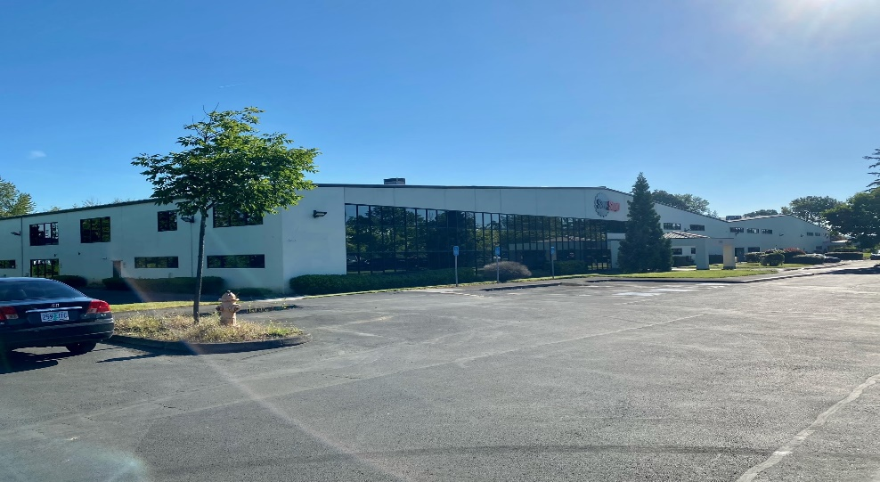
Building Design (TDC 73A)
Myslony Street/112th Intersection (west)
Myslony Street/112th Intersection (east)
Under Construction end of SW Myslony St.
SW MYSLONY - Abutting to East
AR 21-0018
Walgraeve Industrial Park (Hedges Creek)
ARCHITECTURAL REVIEW BOARD
June 29, 2022
18
Notes:
Illustrated here are other industrial building near the development site.
Two top pictures illustrate industrial building located south of the intersection of SW Myslony Street and 112th Avenue
Lower left hand corner is a building currently under construction at the eastern terminus of SW Myslony St.
Lower right is the building that abuts the subject property to the west.

Slide 19
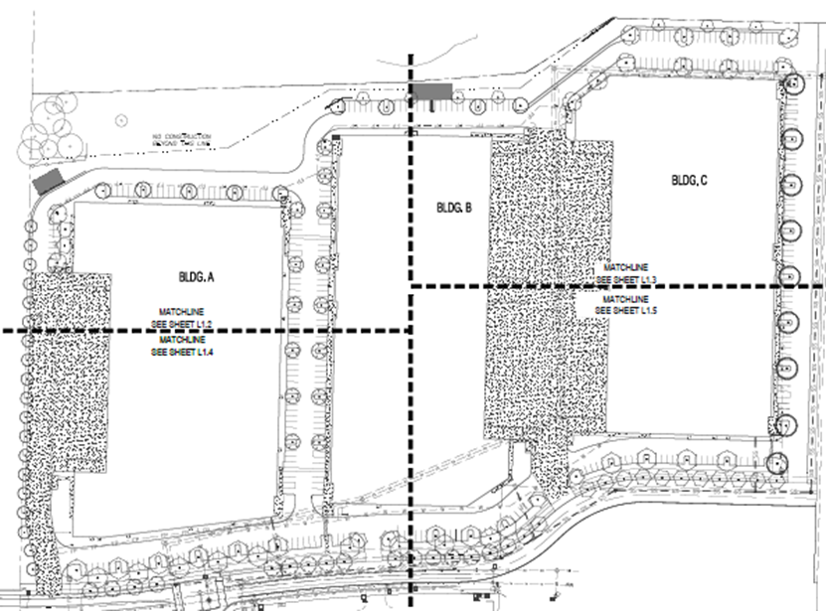
Landscaping Standards (TDC 73B)
The application demonstrates the proposal complies with requirements for:
Minimum landscape area (15%)
Landscape buffers
Tree preservation
Irrigation
Revegetation of disturbed areas
Minimum standards for plantings
AR 21-0018
Walgraeve Industrial Park (Hedges Creek)
ARCHITECTURAL REVIEW BOARD
June 29, 2022
19
Notes:
While the proposal complies with Chapter 73B standards, staff recommends standard conditions of approval in support of tree preservation measures during construction, revegetation and post construction activities.
Somewhere between 15.67% and 16.2% of the site will be landscaped, which meets the required minimum of 15%.
As previously mentioned, staff has recommended the applicant submit an updated landscaping plan
And a condition of approval has been recommended for additional screening for the loading docks.

Slide 20
Parking Standards (TDC 73C)
The application demonstrates the proposal complies with requirements for:
Minimum parking requirements (335 proposed, 305 required)
Bike parking (50 proposed, 45 spaces required)
Parking / drive aisle standards
Loading standards
Parking lot landscaping
AR 21-0018
Walgraeve Industrial Park (Hedges Creek)
ARCHITECTURAL REVIEW BOARD
June 29, 2022
20
Notes:
Chapter 73C provides standards for parking facilities.
The applicant has proposed 335 parking stalls with 305 being required.
50 bicycle parking stalls are proposed with 45 being required
The drive aisle, loading and parking lot landscaping were also reviewed by staff and comply with code requirements.

Slide 21
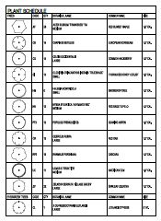
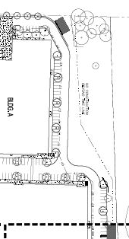
Parking Standards (TDC 73C)
With conditions, the proposal complies with TDC 73C.240(4):
Must be planted with one deciduous shade trees for every four parking spaces; Required trees must be evenly dispersed throughout the parking lot
AR 21-0018
Walgraeve Industrial Park (Hedges Creek)
ARCHITECTURAL REVIEW BOARD
June 29, 2022
21
Notes:
The standard for parking lot landscaping requires one deciduous shade tree for every 4 parking spaces.
Staff has recommended an updated landscaping plan that will include parking lot landscaping.
With the recommended conditions of approval the application will better meet the requirements of Chapter 73C.

Slide 22
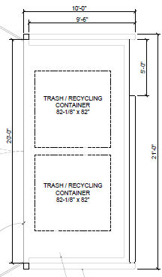
Waste and Recyclables (TDC 73D)
With conditions, the proposal complies with requirements for:
Minimum storage area
Location
Design / screening
TRASH ENCLOSURE
AR 21-0018
Walgraeve Industrial Park (Hedges Creek)
ARCHITECTURAL REVIEW BOARD
June 29, 2022
22
Notes:
The applicant has proposed to use the Minimum Standards Waste Method, as described in Chapter 73D.030. The development code finds this method is the most appropriately used when specific uses or tenants are not known.
- Six trash enclosures, two for each building, are proposed to serve the overall development.
- The enclosures will be located at the north and south ends of each building.
- A condition of approval has been provided that addresses required waste and recycling requirements.

Slide 23
Public Improvements (TDC 74)
TDC 74.610 Water Service. No upgrade is required for the existing 16-inch public main within SW Myslony Street. The proposal includes one three-inch domestic and two ten-inch fire service laterals with gate valves near the main.
TDC 74.620 Sanitary Sewer Service. The applicant proposes to relocate an existing 21-inch public sanitary sewer line that cuts diagonally through the site to SW Myslony Street to the east property line, then along the east property line within a 15-foot wide public sanitary sewer easement, and then reconnecting to the existing line near the northeast corner of this development. (may use Ice Age Tonquin Trail easement for relocated line)
AR 21-0018
Walgraeve Industrial Park (Hedges Creek)
ARCHITECTURAL REVIEW BOARD
June 29, 2022
23
Notes:
TDC 74 provides standards for public improvements.
- Water – No upgrade will be required for the existing public water main. The applicant has proposed one 3-inch domestic and two 1-inch fire service laterals with gate valves near the main.
- Sanitary Sewer – The applicant has proposed to relocate an existing 21-inch public sanitary sewer line that currently cuts diagonally across the site.
- The sanitary sewer line could be located within the easement for the Ice Age Tonquin Trail.
Conditions of approval have been provided to address standards within Chapter 74.

Slide 24
Public Improvements (TDC 74)
With conditions, the proposal will require compliance with both the City and CWS storm drainage requirements, or an acceptable alternative.
TDC 74.630. - Storm Drainage System. Storm drainage near the north end of the site will be treated by vegetated corridor as filter strips with most of the impervious area by Bio-Clean’s stormwater biofiltration system vaults. Underground detention systems will assure the overall site release rates match pre-development up to the 25-year storm event and hydromodification requirements. Some locations are unable to be detained due to topography but equivalent detention will be provided where possible.
AR 21-0018
Walgraeve Industrial Park (Hedges Creek)
ARCHITECTURAL REVIEW BOARD
June 29, 2022
24
Notes:
The applicant has proposed an underground stormwater detention system for up to the 25-year storm event and hydromodification requirements required.
There are some areas that can’t be detained due to topography but equivalent detention will be required where possible.
With recommended conditions of approval, the proposal will require compliance with both the City and CWS storm drainage requirements, or an acceptable alternative.

Slide 25
Site Access
Ingress/egress for industrial uses with over 250 parking spaces must provide driveways at a maximum width as required by the City Manager
AR 21-0018
Walgraeve Industrial Park (Hedges Creek)
ARCHITECTURAL REVIEW BOARD
June 29, 2022
25
Notes:
The applicant proposes four points of ingress and egress along the SW Msylony Street Frontage.
The City’s transportation consultants reviewed and recommended approval of the proposed driveway locations.
The City Manager or, in this case the ARB, will determine if the proposed driveway widths ranging from 26 feet to 40 feet are appropriate.

Slide 26
Access Management (TDC 75)
TDC 75.140. - Existing Streets Access Standards. The eastern driveway must be a minimum of 36 feet wide either matching the existing recorded access easement or with a new or modified access easement to serve the lot to the north.
Half street improvements will be required north of the SW Myslony Street centerline including curb and gutters, striping, planter strip and sidewalk.
AR 21-0018
Walgraeve Industrial Park (Hedges Creek)
ARCHITECTURAL REVIEW BOARD
June 29, 2022
26
Notes:
Chapter 75 provides access standards for existing streets.
Staff has recommended that the easternmost driveway be increased from the proposed width of 30 feet to 36 feet.
Half street improvements will be required from the SW Myslony Street centerline including curb and gutters, striping, planter strip and sidewalk.
With staff recommended conditions of approval the requirements of Chapter 75 will be met.

Slide 27
Conclusion
The findings demonstrate that the proposal meets the applicable criteria of the Tualatin Development Code with the recommended Conditions of Approval.
Therefore, staff respectfully recommends approval of the subject Architectural Review application (AR 21-0018), as conditioned.
Questions?
AR 21-0018
Walgraeve Industrial Park (Hedges Creek)
ARCHITECTURAL REVIEW BOARD
June 29, 2022
27

