Slide 1

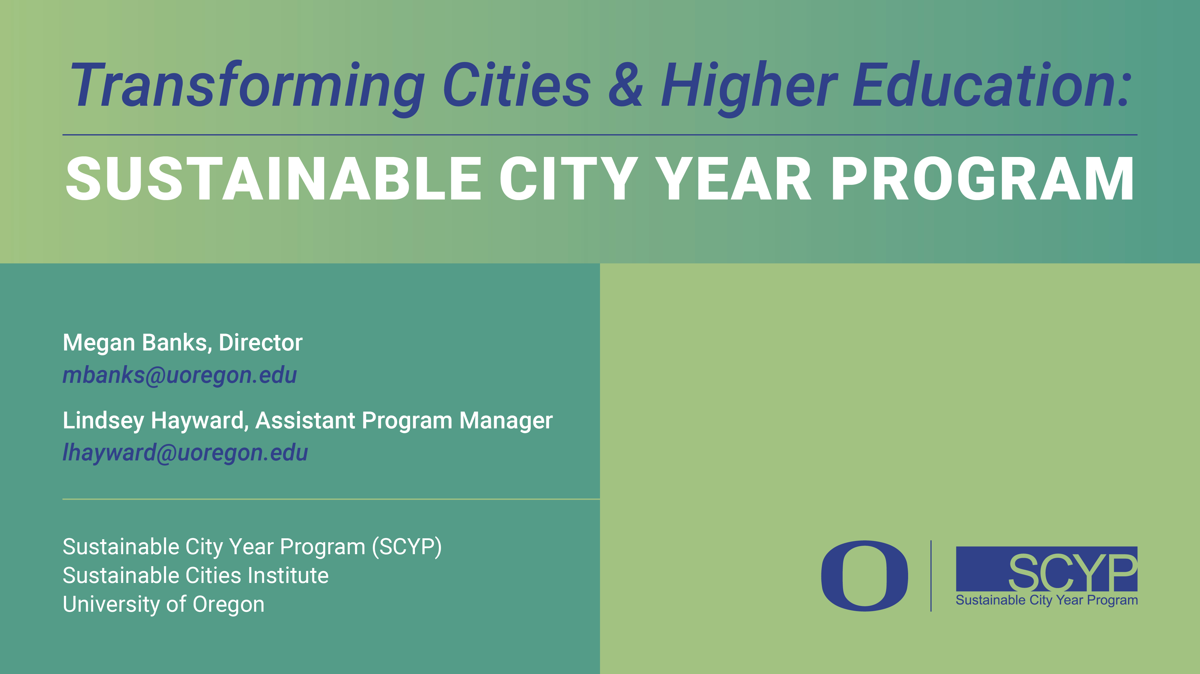
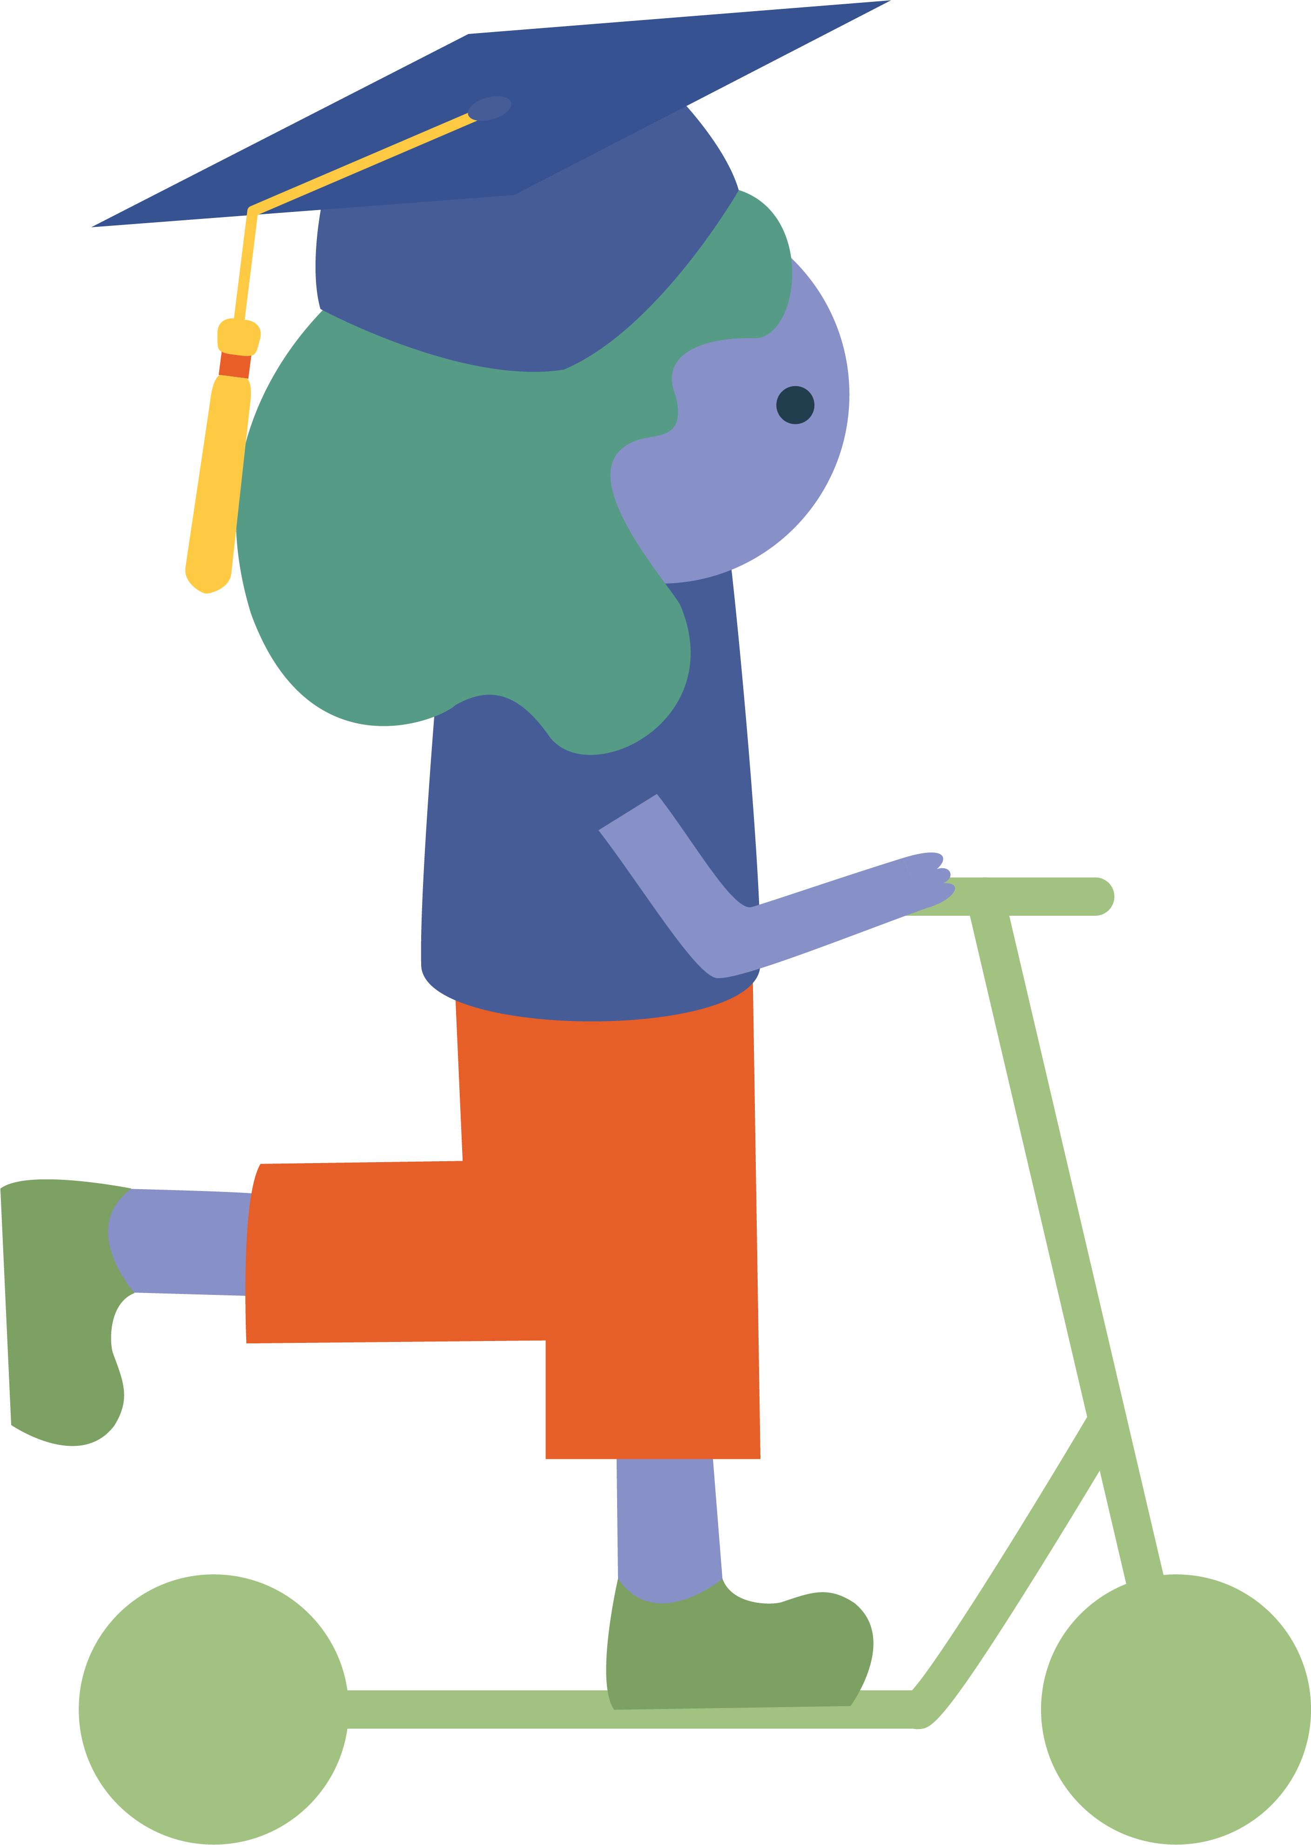


Slide 2

What is the Sustainable City Year Program?
Through year-long partnerships, SCYP helps communities solve today’s problems while laying the groundwork for a sustainable future — all while helping students prepare for the workforce through applied learning.
Notes:
The world needs research and ideas and solutions – leveraging the role of universities for the benefit of society is critically important.
Local government is where change happens; but with everything that needs to be done, it can be hard to find the time to seek out best practices or new knowledge, or there may not be the political space to try new ways of doing things. Conversely, for universities, part of their reason for being is to figure out new ways of doing things.
How does SCYP do this?

Slide 3
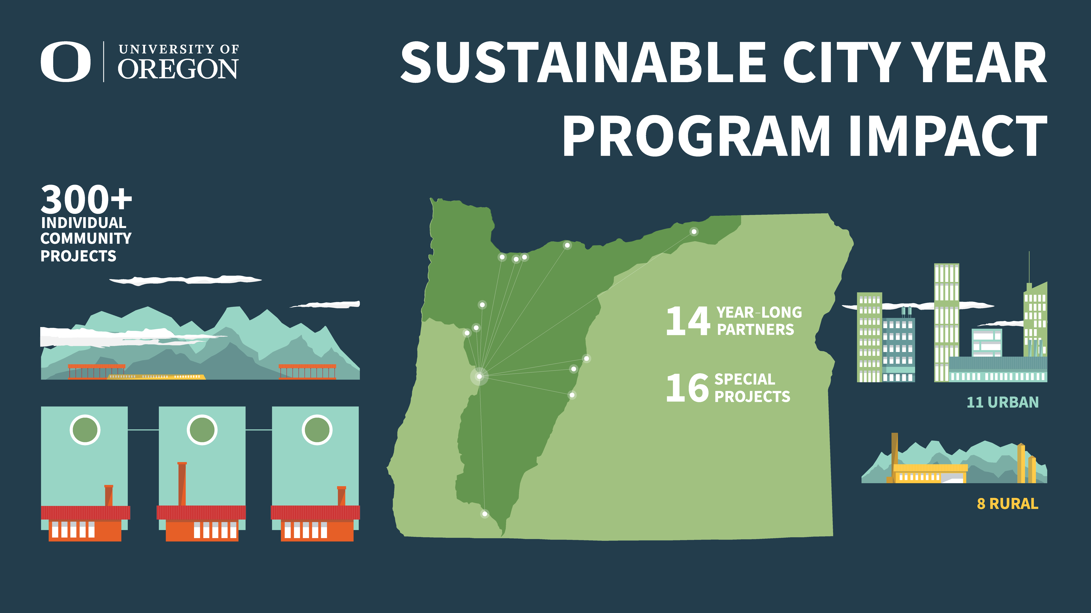
*
*AS OF 2024
Notes:
As a quick overview, as of 2024, SCYP has completed over 300 community projects
We’ve worked with 14 community partners since we started in 2010, with a mix of urban and rural locations
Periodically, we complete a special project, which is something other than a full-year partnership.

Slide 4
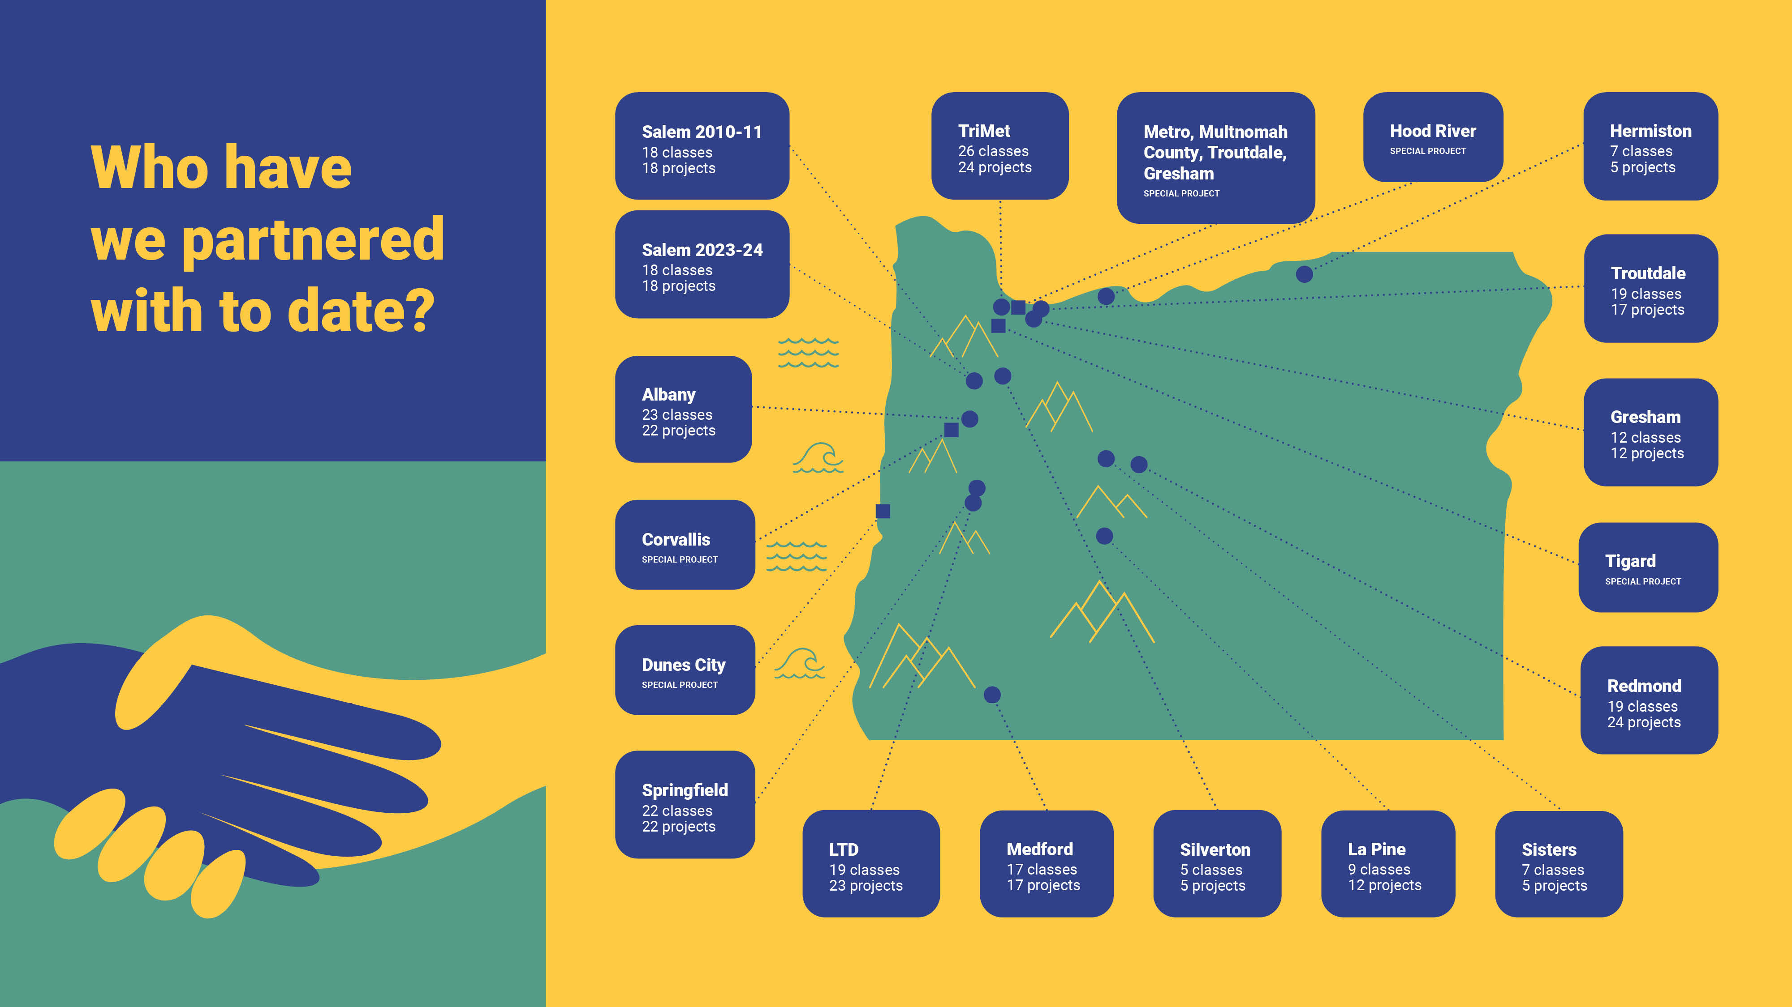
*
*AS OF 2024
Notes:
We partner statewide, from southern Oregon to northeast Oregon, from the Willamette Valley to central Oregon.
SCYP is providing the mechanism to get knowledge into practice and help universities improve the quality of life for Oregonians.
As part of our TriMet year, we worked in Tualatin

Slide 5

One year
with SCYP
can include...
200-500 STUDENTS
10-30
COURSES
5-15 DISCIPLINES
10-20 FACULTY
Notes:
What does SCYP include?
It varies depending on the partner but in summary, we take existing classes taught in their existing ways and direct them at our partner.
The number of courses, faculty, students and disciplines depends on the partner size
Our intent is to have value add for our partners while students get to be part of a large effort and impact.

Slide 6
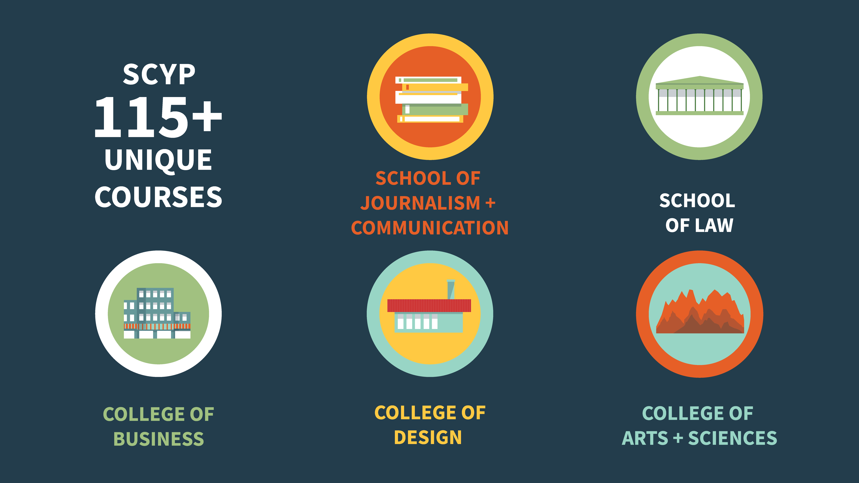
Notes:
We engage with five of our schools and colleges across campus, and have come 115 unique courses.
However, it depends on the projects of interest by the partner city.

Slide 7


Example Disciplines
Architecture
Business
Digital Arts
Economics
Environmental Studies
Geography
Historic Preservation
Interior Architecture
Journalism
Landscape Architecture
Law
Media Studies (video, photography)
Passive Solar Heating
Planning
Product Design
Public Administration
Public Policy
Public Relations
Engineering (PSU, OSU)
Notes:
Since we work across campus for an entire year, different disciplines can bring a different approach or perspective to common problems, creating more well thought out solutions for communities to consider
Sometimes other public universities in Oregon participate—Portland State, Oregon State and Eastern Oregon have been a part of past partnerships.
This puts the public back in public university in Oregon

Slide 8

In summary, SCYP:
Provide capacity for communities
Apply creative solutions to real life issues
Help society meet pressing challenges
Create a transformational model for higher education
Workforce development (your future employees?)
Notes:
In summary,
We want SCYP to be a transformational model for higher education
Experiential learning motivates students and build relationships with our communities across the state
We bring workforce development to campus – students are working on and helping to solve real problems
We provide capacity - communities have so many needs and never enough resources to get everything done
On a broader level, we want to help society meet its pressing challenges, from climate change to sustainability

Slide 9
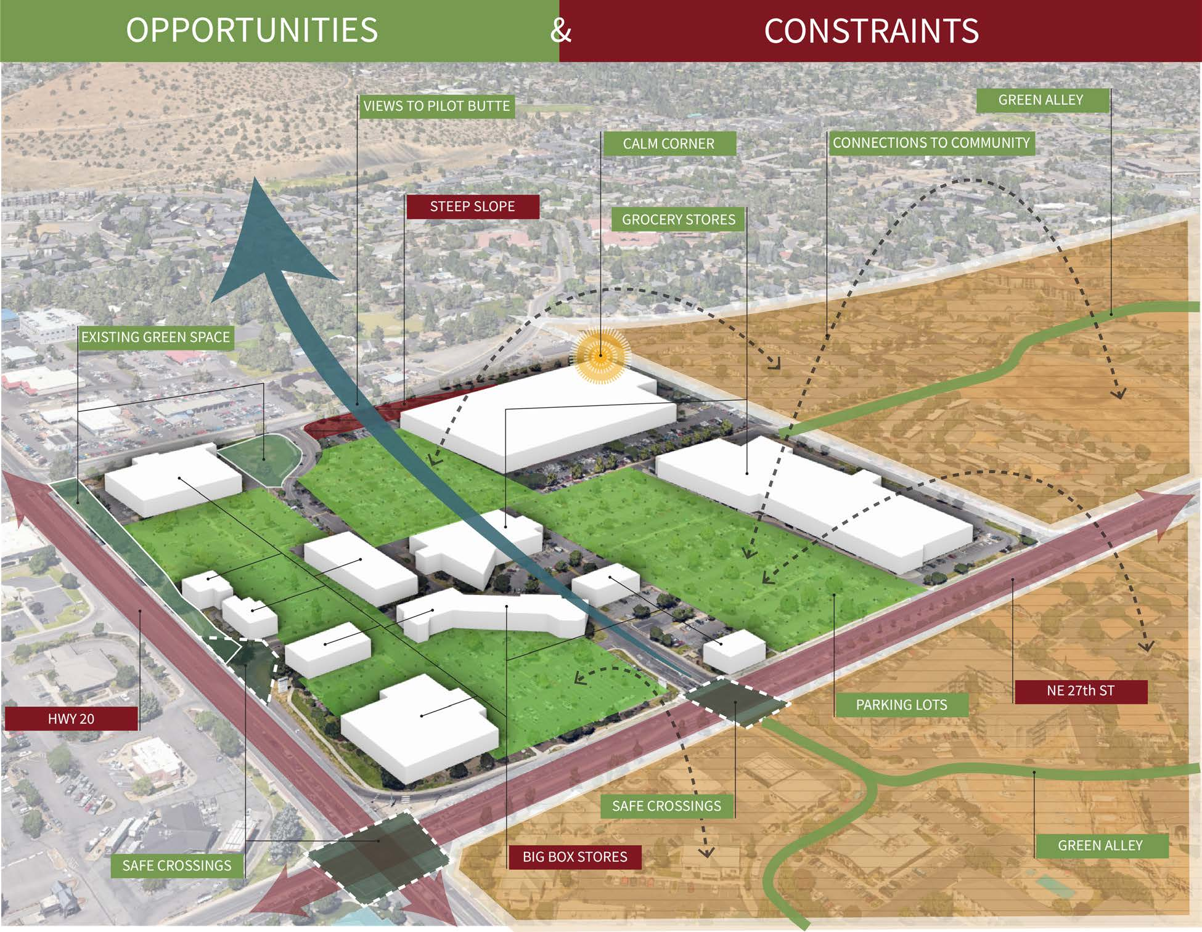
Past Project, Bend (Planning Students)
Themes:
Walkability and Transportation
Climate Resilience
Public Placemaking
Equitable Community
Notes:
Coming down to the ground level…I’d like to share some recent project examples.
Student teams redesigned a 35-acre commercial site on Bend’s east side, with each team applying a unique theme ranging from Walkability and Transportation; Climate Resilience; Public Placemaking; to Equitable Community. Teams analyzed demographics, economics, and housing needs to inform their proposals, aiming for flexible, community centered designs.
Students met with City of Bend growth mgmt. staff and two city councilors

Slide 10
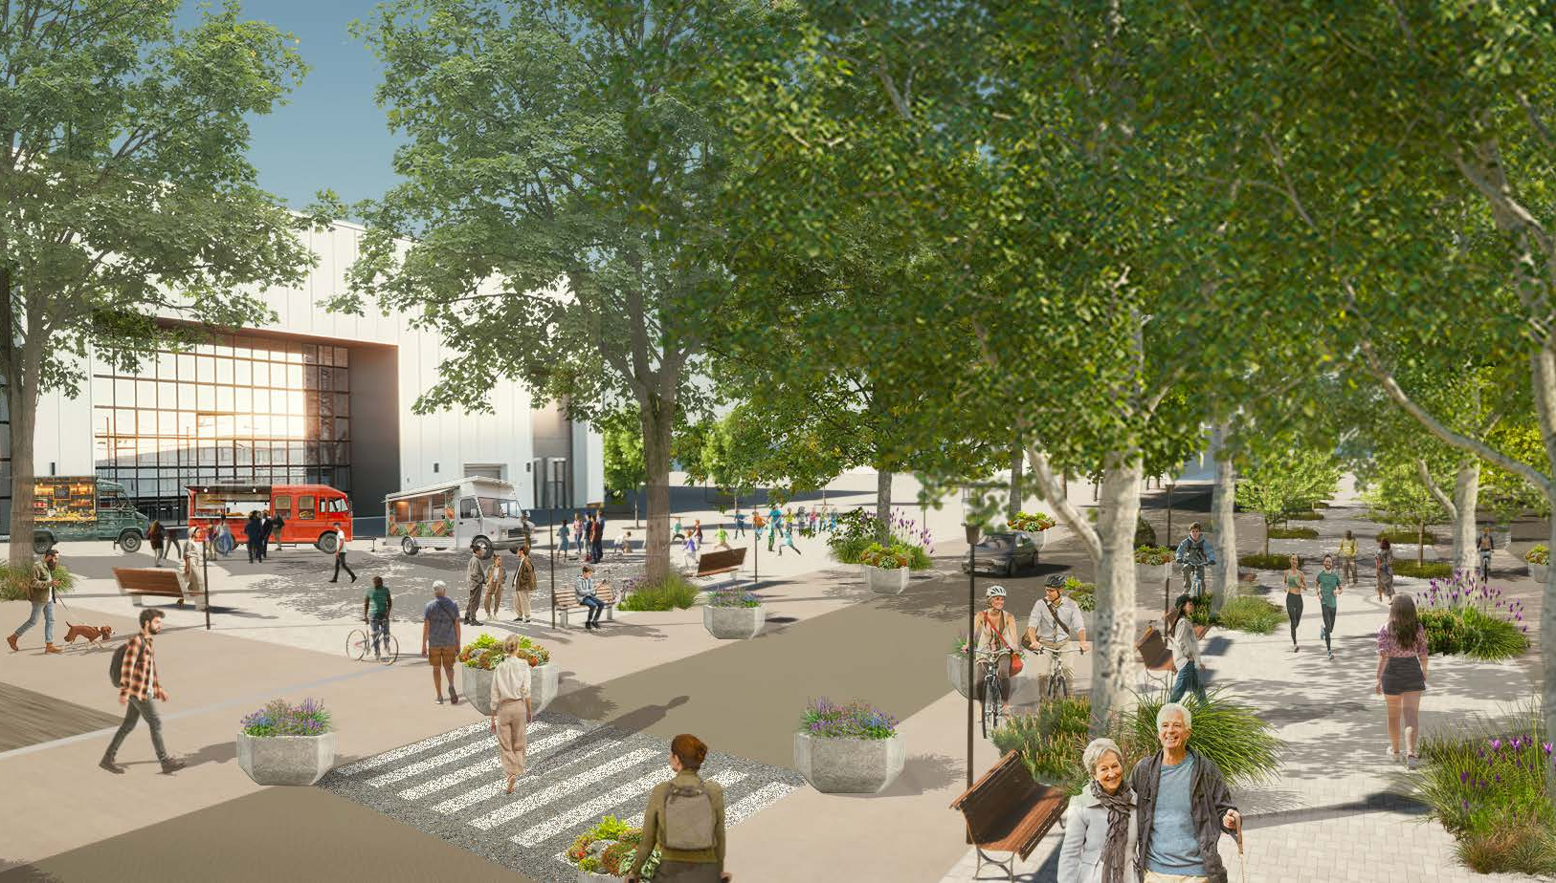
Past Project, Bend (Planning Students)
Mobility options: on- and off-site transportation networks
Affordable housing: support local workforce
Green spaces: healthy lifestyle for all ages, incomes, and abilities
Notes:
As a Climate Friendly Area (CFA) opportunity site, students focused on planning and designs that contained a mix of housing, employment, businesses, and services within a short distance so that residents, workers, and visitors could walk, bike, or use public transportation, as well as have direct access to various public-space amenities and parks.
Mobility options: on- and off-site transportation networks
Affordable housing: support local workforce
Green spaces: encourage a healthy lifestyle for all ages, incomes, and abilities

Slide 11
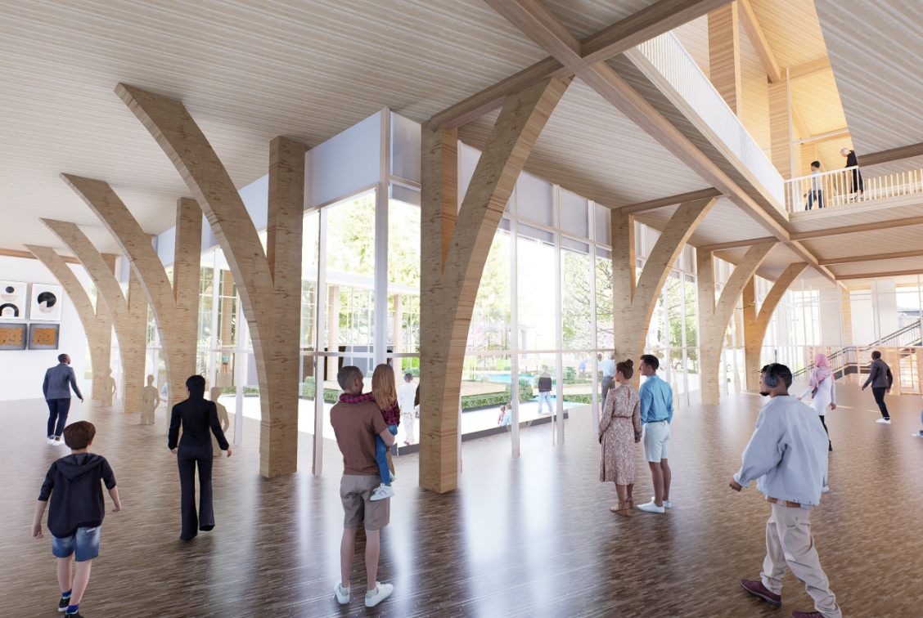
Past Project, Gresham (Architecture Students)
Create a vibrant, small-scale, walkable downtown
Activate adjoining Main City Park
Design a community center that elevates inclusivity
  ensure people feel safe
  serve Gresham’s diverse ethnic communities, city residents, and all ages
Notes:
The key goals of the partnership in between SAE Design Studio (Vision for Gresham) and Gresham City council are to align with the Downtown Gresham Conceptual Framework Project by creating a vibrant, small-scale, walkable downtown, activating the main city park, and designing a community center that elevates inclusivity, ensures people feel safe, and serves Gresham’s diverse ethnic communities, city residents, and people of all age groups. Gresham is home to a rich demographic, with over 30% of its population identifying as Hispanic, Asian, and from other ethnically diverse backgrounds. However, the city currently lacks a unified communal space where these communities can gather, celebrate culture, and feel represented. University of Oregon architecture students engaged in a participatory design process to address this need—envisioning a community center that serves both as a cultural anchor and a physical connector to Gresham’s natural assets, including the Gresham Main City Park, Johnson Creek, and the Springwater Corridor Trail.
Through site visits, interviews, landscape surveys, and partnerships with local schools, libraries, architects, and forums, students explored how public space can better serve Gresham’s communities. The current disconnects between city life and its magnificent natural surroundings inspired proposals to activate the park’s entrance and reimagine it as a vibrant social hub. The project integrates direct input from residents through interviews and community archiving, ensuring the final design is informed by the voices of those who will use it.

Slide 12
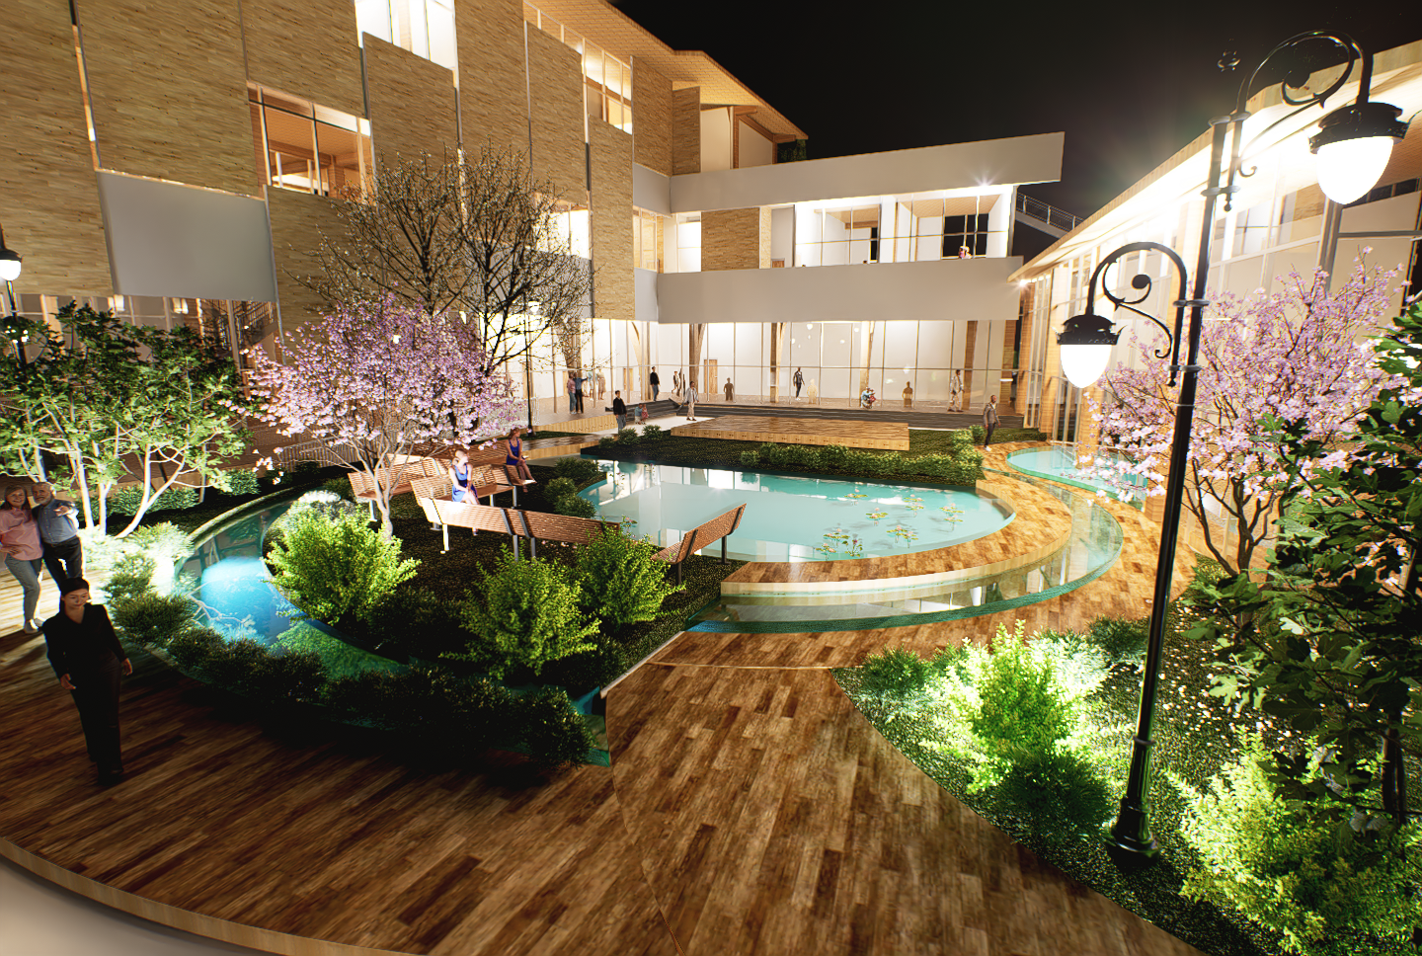
Past Project, Gresham (Architecture Students)
Youth-oriented, sports areas
Food access, restaurants and communal dining
Smaller, intimate outdoor or semi-outdoor spaces for informal gatherings, neighborhood-level connection
Spaces that prioritize vulnerable populations privacy and support > meditation rooms, healing gardens, and reflective areas that foster wellness
Notes:
Design proposals varied
Youth-oriented centers and a Sports Arena with flexible programming
Food access and security, responding to the city’s desire for more restaurants and communal dining opportunities
Smaller, more intimate outdoor or semi-outdoor spaces that promote informal gatherings and neighborhood-level connection.
Recognizing the diversity of Gresham’s residents, spaces that prioritize privacy and support for vulnerable populations. These included meditation rooms, healing gardens, and reflective areas that foster wellness. Across all proposals, students worked to balance broad community goals with the nuanced, everyday needs of individuals and families.

Slide 13
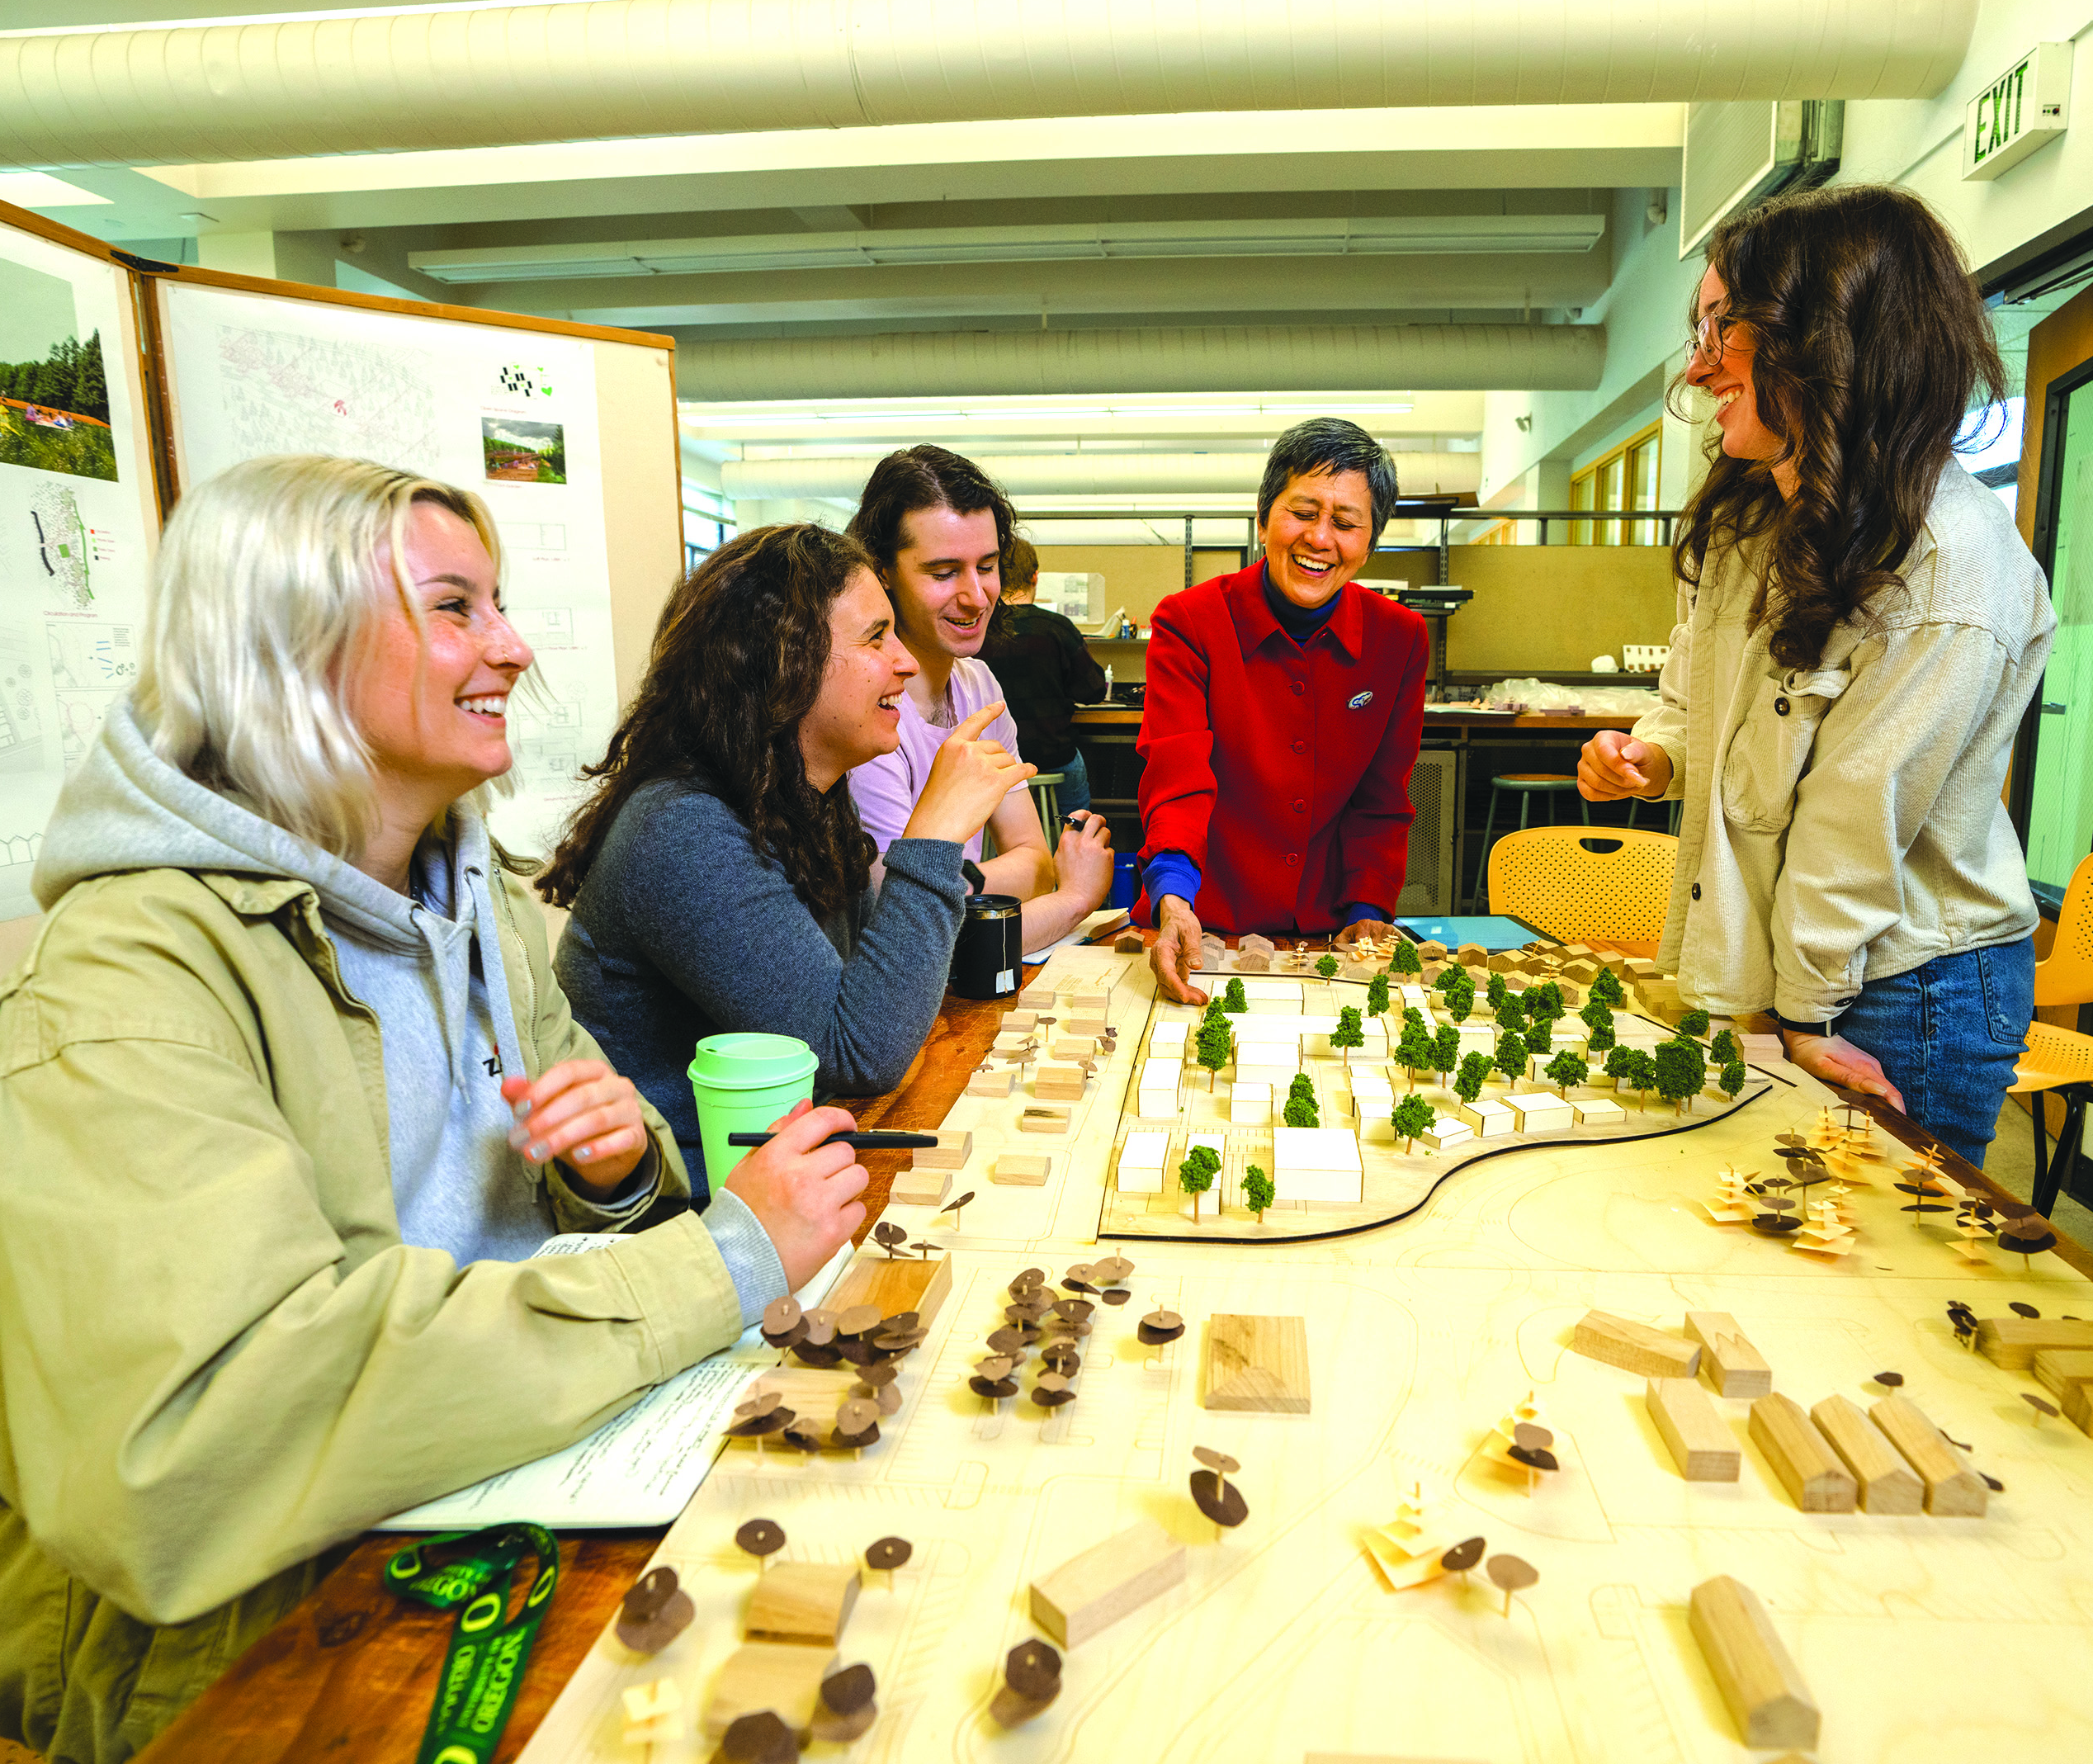
Past Project, Sisters (Architecture Students)
Sisters Elementary School and Site Adaptive Reuse:
Workforce housing
Community recreation uses and spaces as design anchors > community center, indoor and outdoor recreation areas
Increased density housing: apartments, duplexes, and quadplexes
Notes:
Depending on the project, students engage with the community, which could include elected officials, staff, stakeholders and the community at large. In Sisters, planning students collaborated with
The city of Sisters,
Sisters School District
Sisters Parks and Recreation District partnered to evaluate the future of the existing Sisters Elementary School site.
Site visit - met with city staff, school superintendent, city council president, etc.

Slide 14
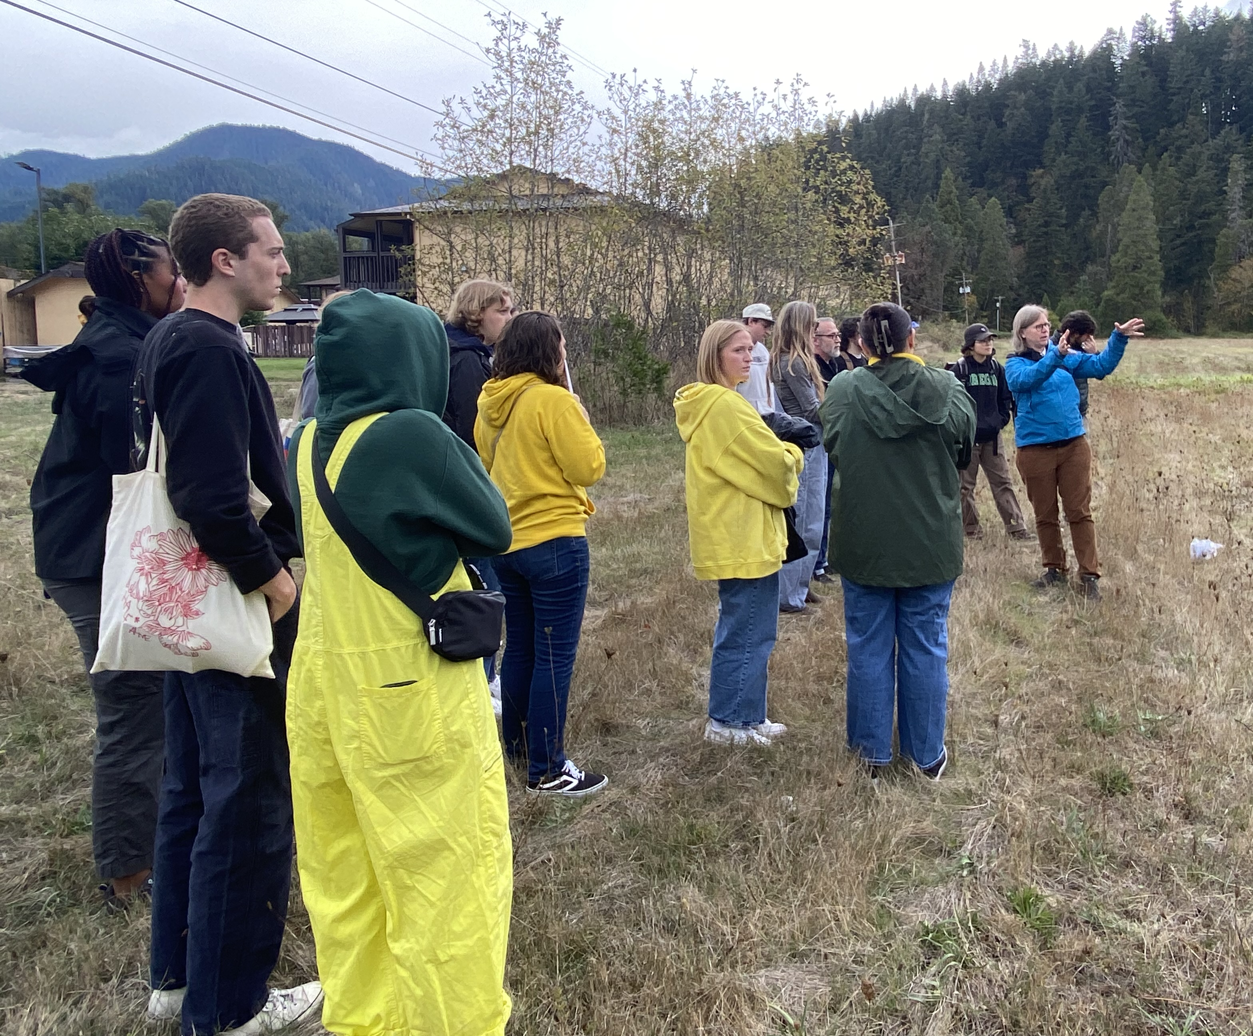
Past Project, Oakridge (Architecture Students)
Student designs informed by :
Multiple site visits
Visits to the Oakridge museum, first Friday Art Walk, city council meeting
Conversations with city staff, elected officials, stakeholders such as property owners and local realtors, and community members
Notes:
Middle Housing design – not currently allowed by zoning code
Student experiences:
Multiple site visits
Visits to the Oakridge museum, first Friday Art Walk, city council meeting
Students designs informed by:
City staff
Elected officials
Stakeholders (property and business owners, local realtors, etc.)
Community members

Slide 15
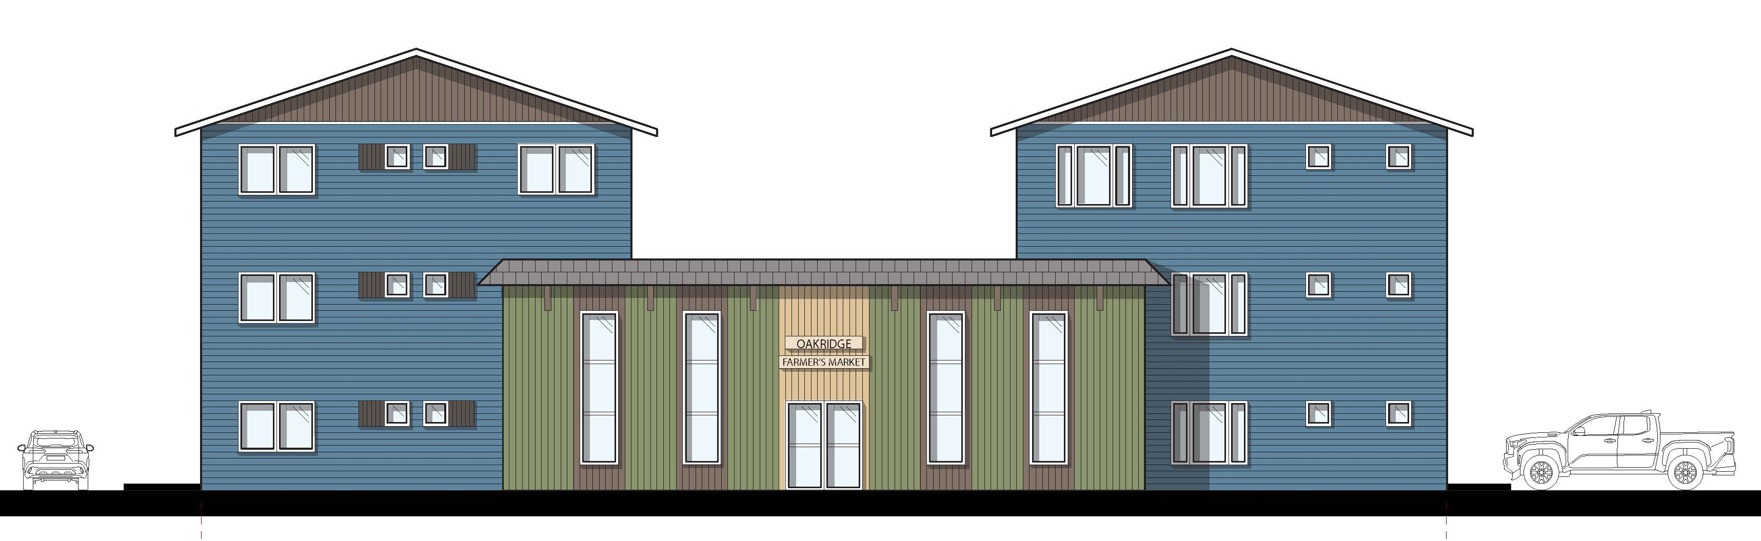

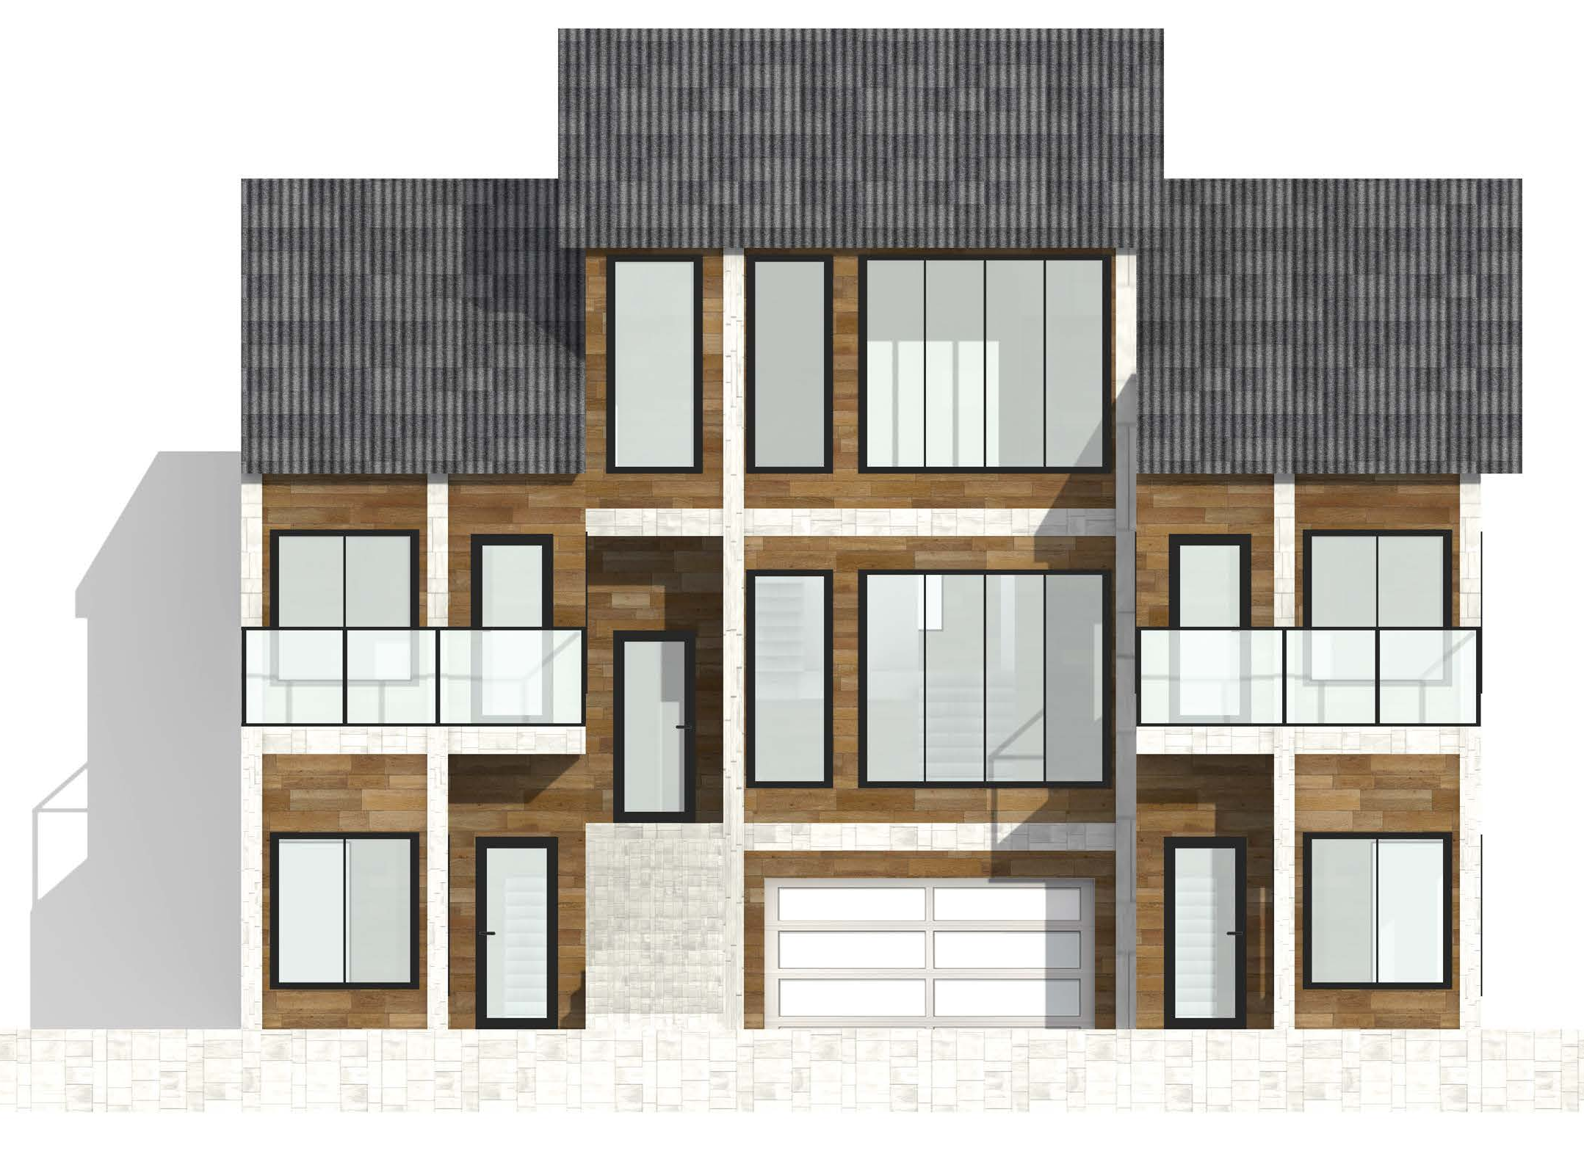
Past Project, Oakridge (Architecture Students)
Student housing designs focused on:
Context sensitivity > blending new development into existing urban fabric
Architectural cohesion
Privacy
Fostering community
Emphasis on sustainability, daylight access, walkability

Slide 16
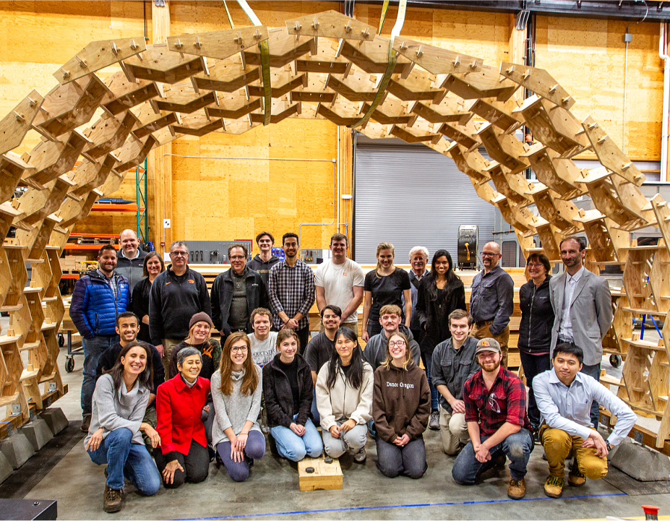
Past Project, Salem
UO Arch & OSU Engr’g
Seasonal pavilion, Highland Park
Sustainable reuse of materials such as plywood and Mass Plywood Panels (MPP)
Reciprocal frame construction, “kit-of-parts” methods
Notes:
Exploring innovative kit-of-parts construction methods, our project centers on the adaptable nature of reciprocal frame construction, focusing on sustainable reuse of panel materials such as plywood and Mass Plywood Panels (MPP). The University of Oregon (UO)-Oregon State University (OSU) collaboration generated diverse ideas for a small seasonal pavilion in Salem, Oregon’s Highland Park. Following a review, the class united to consolidate the best concepts into a singular project. Operating as one team, the class developed construction details, prefabricated components, and sequenced on-site assembly. The OSU-UO Tallwood Design Institute’s (TDI) Emmerson Lab, UO College of Design’s Computer Numerical Control (CNC) machine, and CNC WoodCutters machined trial and final components. Student-led assembly and installation took place in Week 10, with a final review and installation in the Emmerson Lab. The insights of the review, along with the work of the term, culminated with many lessons learned and a new set of guidelines for an outdoor installation in Highland Park

Slide 17
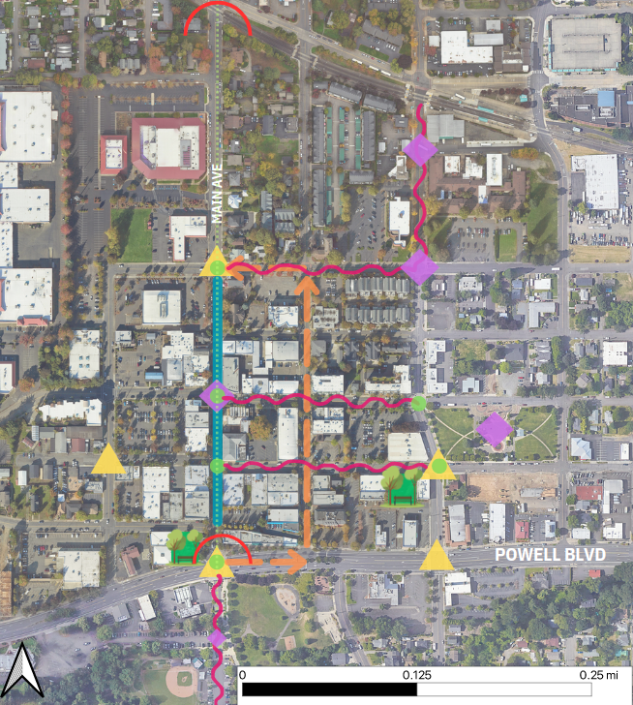
Past Project, Gresham (Urban Transportation)
City goals:
More walkable downtown, greater variety of downtown programming
Design ideas:
Close or one automobile lane, North Main Avenue > increase multimodal transportation options
Centralized downtown wayfinding signage
Notes:
Despite these challenges, student researchers suggested ways to bring new life to the Historic Downtown area while keeping its small town-like charm. The most frequently suggested recommendation was to close a corridor of N Main Avenue to automobile traffic. The proposed corridor is from NE 1st to NE 5th Street, and would include a two-way bike lane, large sidewalks for pedestrians, and increased social spaces. This, along with infrastructure improvements to nearby intersections, would make walking and biking a more attractive alternative to driving downtown. Alternatively, if the city decided against a walking- and biking-only corridor, Gresham could turn N Main Street into a one-way. The unused lane could be converted into a two-way protected bike lane and would accomplish the same goal of encouraging multimodal transportation.
Another common theme researchers suggested was improved and centralized signage downtown. The city could create more cohesive wayfinding signage directing visitors to special attractions like the parks and local businesses nearby. The signage could also better direct drivers to underutilized parking lots to address community members’ perceived lack of parking in the area. The use of bulletin notice boards could offer information about biking and walking as viable and safe travel options in Gresham. Other important recommendations addressing Gresham’s Historic Downtown District’s needs include infill underutilized parking lots with social space hubs, engage with local artists and students to create public art downtown and increase aesthetic pleasure in the area, and implement a street fair to celebrate new development downtown.

Slide 18
Next Steps for Individual Classes

